Slide 1
Fernando Cabanillas, Jorge Bertrán-Pasarell, Ricardo Fernández,
Javier Morales, Yaimara Hernández-Silva et al
Funded by Puerto Rico Consortium for Clinical Investigation
Financial Disclosures- no relevant conflicts of interest
Protocolo Tratamiento Covid-19 Auxilio Mutuo
NOVEL PREEMPTIVE APPROACH TO PREVENT CYTOKINE RELEASE SYNDROME (CRS) BASED ON BLOOD MARKERS

Slide 2
Reconocimiento especial a nuestros patrocinadores

Slide 3
Caso clínico ilustrativo
Paciente 58 años presenta el 13 octubre,2020 con mialgias moderadas después de haber regresado de un viaje a EEUU.
Prueba molecular Covid positiva.
Paciente nos llama y lo registramos en el protocolo Covid del Auxilio Mutuo.
No presentaba tos, disnea, diarrea, ni anosmia.
O2 sat= entre 96% a 97% por oximetría.
7 días después de presentar el primer síntoma, le ordenamos marcadores de inflamación en sangre: (CRP, LDH, ferritina, D-Dimers, Interleukin-6)
Solamente la LDH estaba elevada significativamente
Se le ordena un CT tórax
Ese mismo día empieza a desaturar gradualmente y la O₂ sat llega a 94% por oximetría
desarrolla dolor en base izquierda del pulmón.
Estaba entrando en la fase inflamatoria 2-b y para evitar la tormenta de citoquinas lo comenzamos en tratamiento en nuestro protocolo para Covid-19
A las 24 horas la O₂ sat ya había subido a 97% y a las 72 horas el paciente pudo correr 1.7 millas en la playa usando una mascarilla

Slide 4
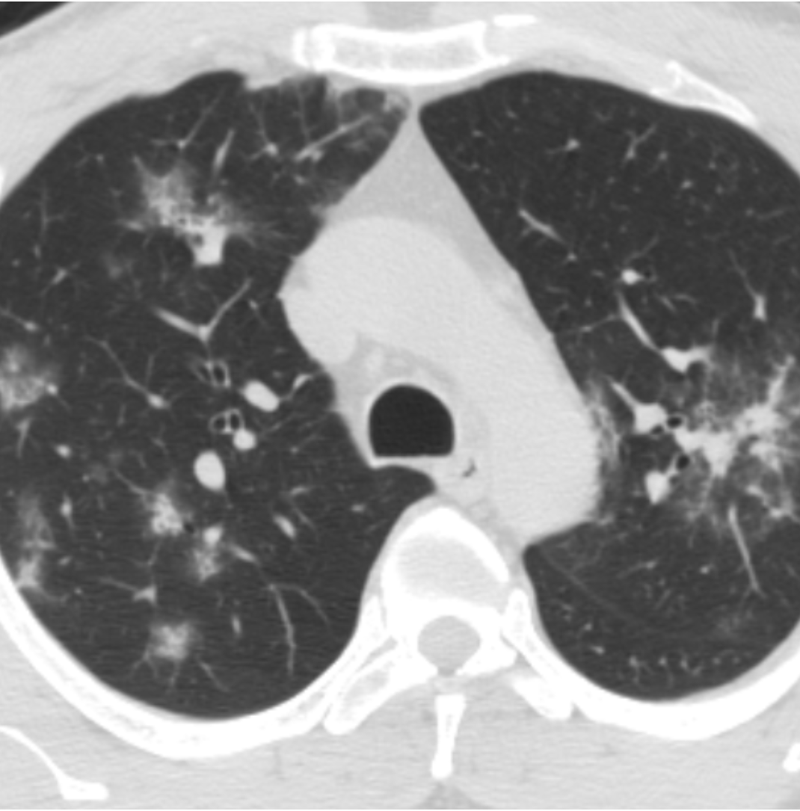
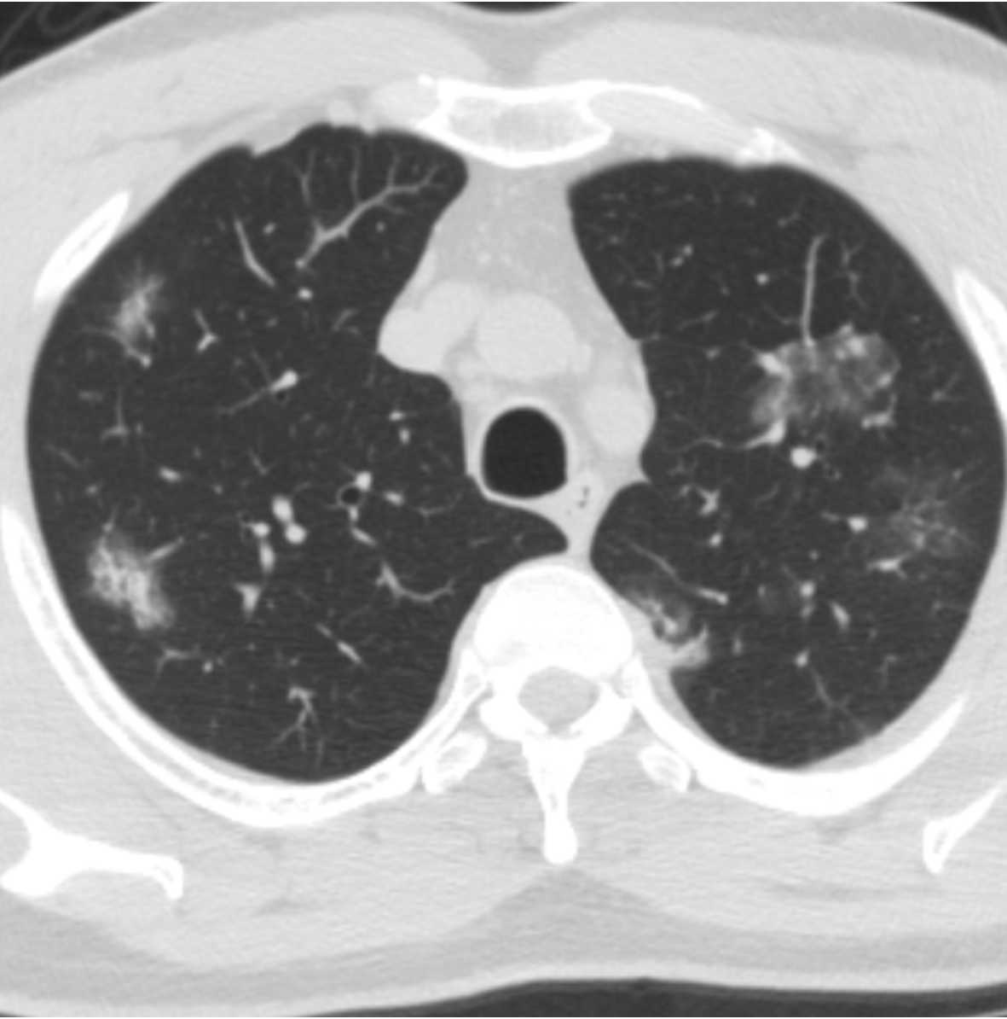

Slide 5
Dr. Lorenzo González Feliciano Inflammatory Markers Before and After Methylprednisolone

Slide 6
Cytokine Storm
7 days from 1st symptom
|
~ 10 days |
~11-15 days
| >15 days
In ~25% of cases, pro-inflammatory markers in serum are elevated at end of viral phase and in stage IIA.
Those are the ones that we primarily target for pre-emptive therapy with Methylprednisolone.
Some cases with stage II-b were also included provided their O₂ sat was not <91%.
Modified from:

Slide 7
NOVEL PREEMPTIVE APPROACH TO PREVENT CYTOKINE RELEASE SYNDROME (CRS) BASED ON BLOOD MARKERS
BACKGROUND
We aimed to identify those 75-80% of cases who are spontaneously cured during the first 7 days as well as the 20-25% who will go on to develop severe disease:
We hypothesized that those with few cytokine abnormalities would have a low risk for progression to respiratory insufficiency and could be observed without treatment.
On the other hand, we proposed that those whose markers and clinical features suggest a high risk for progression, would benefit from preemptive treatment with a short course of methylprednisolone (MPS), to avoid development of cytokine storm.

Slide 8
In our protocol, we want to catch them here: at beginning of inflammatory phase

Slide 9
NOVEL PREEMPTIVE APPROACH TO PREVENT CYTOKINE RELEASE SYNDROME (CRS) BASED ON BLOOD MARKERS
INCLUSION CRITERIA
Age > 21 y/o (no top age limit)
Diagnosis of Covid-19 based on positive PCR test (94% of cases)
OR
Typical clinical signs and symptoms suggestive of Covid-19 such as:
coupled with a positive serological test (5%)
OR
No typical clinical symptoms but positive serological test repeated twice (1%)

Slide 10
NOVEL PREEMPTIVE APPROACH TO PREVENT CYTOKINE RELEASE SYNDROME (CRS) BASED ON BLOOD MARKERS
EXCLUSION CRITERIA
O₂ sat <91%
Any patient with life expectancy <1 month
Any patient who is oxygen dependent
Any patient with long standing history of severe COPD
Any patient who is chronically oxygen dependent because of previously existing lung disease
Anyone with severely uncontrolled diabetes despite adequate management.
Anyone with active serious bacterial infection such as septicemia or pneumonia.
Anyone receiving Tocilizumab (anti-IL-6 therapy) or plasma therapy
Any patient already receiving steroids for another pre-existing illness

Slide 11
Primary endpoint:
Rate of progression to hypoxemic respiratory failure, defined as O₂ saturation of < 91% or p0₂ <60 on room air
Secondary endpoints:
Improvement in serologic inflammatory markers following treatment
% survival at 28 days from registration
NOVEL PREEMPTIVE APPROACH FOR CYTOKINE RELEASE SYNDROME (CRS) BASED ON BLOOD MARKERS
PREDETERMINED CRITERIA

Slide 12
NOVEL PREEMPTIVE APPROACH TO PREVENT CYTOKINE RELEASE SYNDROME (CRS) BASED ON BLOOD MARKERS
CRITERIA FOR INITIATION OF TREATMENT
In order to be treated with Methylprednisolone, patients had to meet >2 of the following criteria:
CRP > 10 mg/dL (100 mg/L)
LDH above normal
Ferritin > 500 ng/ml
D-dimer > 1 mg/L (1,000 ng/ml)
IL-6 > 10 pg/ml
Absolute lymphocyte count (ALC) < 1,000
O₂ sat 91-94%
CT chest with typical findings
Those who met above criteria were given Methylprednisolone 80 mg daily x 5 starting >7 days from 1st symptom
Patients who didn’t meet the above criteria were observed without treatment
From 7/26/20 treatment was given in outpatient setting for those with O2 sat >94%

Slide 13
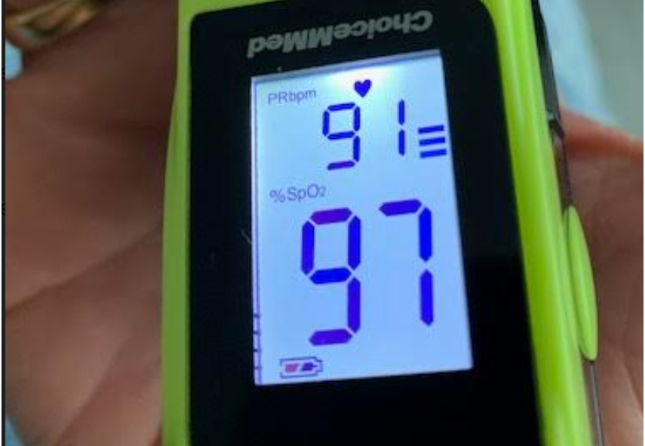

Slide 14
Corticosteroids Dose Equivalence
Steroid | Equivalent Dose | Half life in hours
Dexamethasone | 6 mg | 36-54
Methylprednisolone | 32 mg | 18-36
Triamcinolone | 32 mg | 18-36
Prednisone | 40 mg | 18-36
Steroid corticosteroids dose equivalence

Slide 15
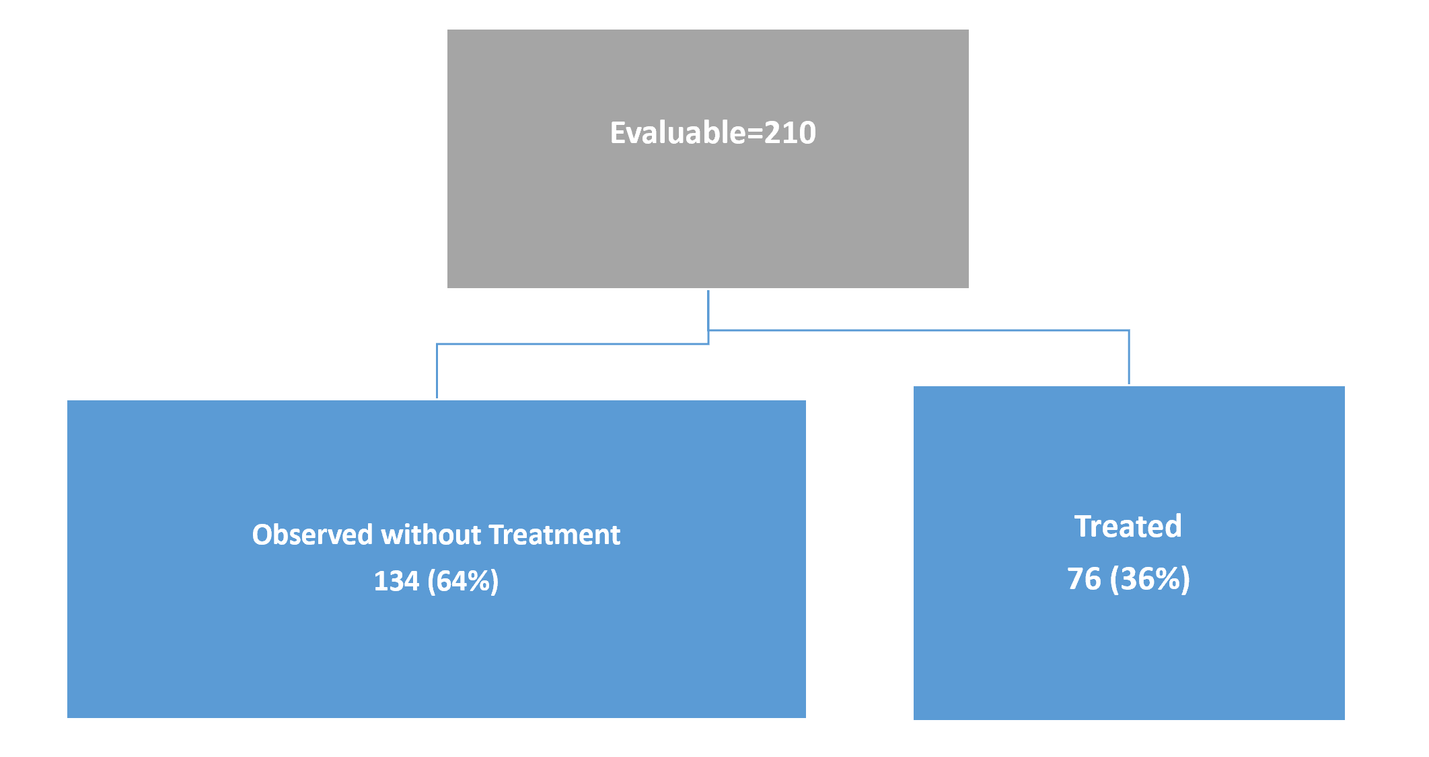
Flow Diagram of Cases Entered

Slide 16
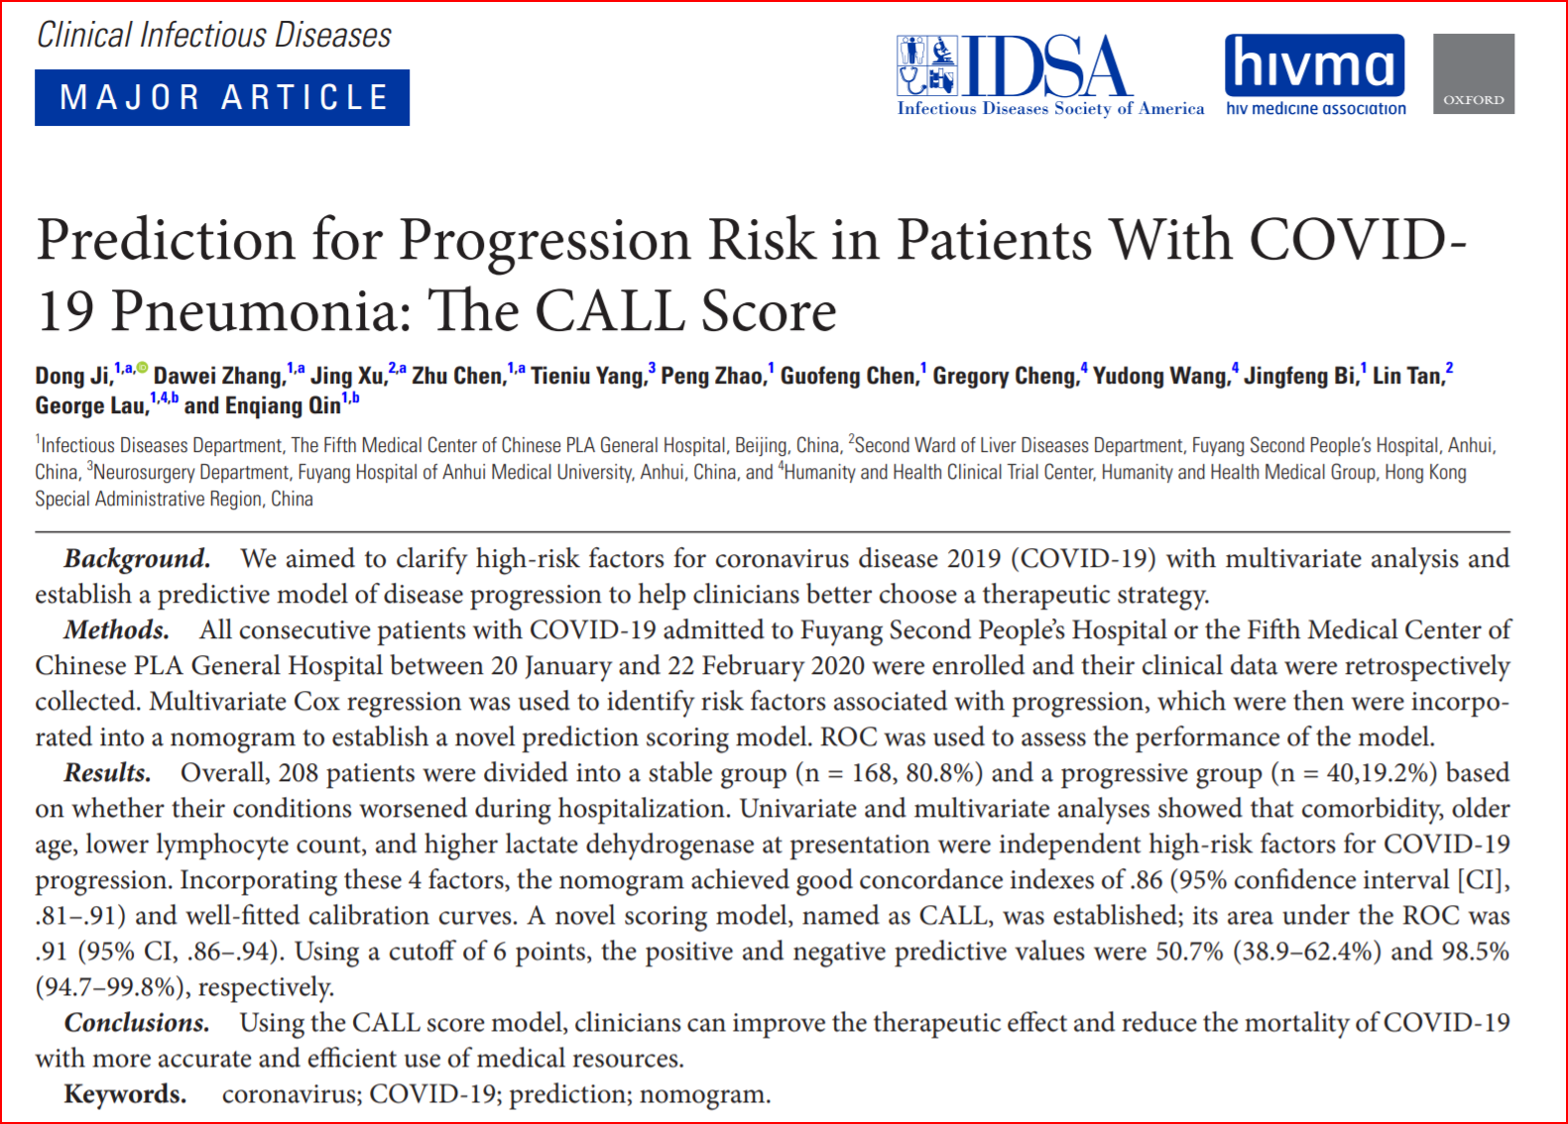

Slide 17
“CALL” SCORE
Comorbidity present: 4 points
Age >60: 3 points
Lymphocyte count <1,000: 3 points
LDH elevation: 2-3 points depending on how high

Slide 18
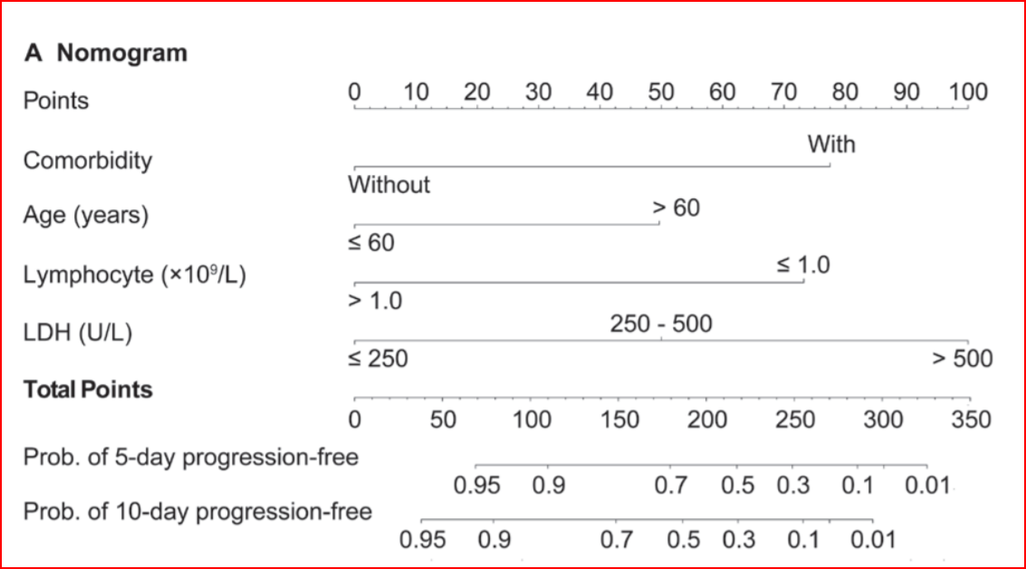
Call Score Nomogram

Slide 19
Demographics
Baseline Features | Not Treated N=134 | % Not Treated | Treated N=76 | % Treated | P value
Gender
Male | 62 | 47 | 40 | 53 | ns
Female | 72 | 53 | 36 | 47
Median Age | 45 | - | 60 | - | .00001
Managed as outpatients | 127 | 100 | 51/67 | 76 | .00001
# Comorbidities per patient | 105 | 78 | 172 |  | .00001
CALL Score:
4-6 (Class A) | 64 | 48 | 14 | 18 | .00001
7-9 (Class B) | 63 | 47 | 36 | 47
10-13 (Class C) | 3 | 2 | 26 | 34
Missing information | 3 | 2 | 0 | 0
O₂ Sat 91-94% | 2 | 1.5 | 23 | 30 | .00001
Symptoms
Fever | 49 | 37 | 48 | 63 | .0001
Dyspnea | 23 | 17 | 29 | 38 | .004
Myalgia | 85 | 64 | 49 | 64 | ns
Diarrhea | 56 | 42 | 33 | 43 | ns
Anosmia | 68 | 51 | 34 | 45 | ns

Slide 20
Management of Covid-19 Using a Risk Based Approach…
Results
Characteristic | All Patients (210) | % | P value | Treated Patients (76) | % | P value | Untreated Patients (134) | % | P value
Expected Cases of Respiratory Failure per “CALL Score” nomogram | 44 | 21 | .0001 | 28 | 38 | .0001 | 13 | 10 | .0001
Observed Cases with Respiratory Failure | 3 | 2 |  | 3 | 4 |  | 0

Slide 21
Required Ventilator
Required BIPAP for Respiratory Failure
Required Additional Steroids
Did well

Slide 22
Required Ventilator
Did well
Required Additional Steroids
Required BIPAP for Respiratory Failure
Did well

Slide 23
Did well
Did well
Required Ventilator
Required Additional Steroids/Tocilizumab
ALC at Baseline versus Day 7

Slide 24
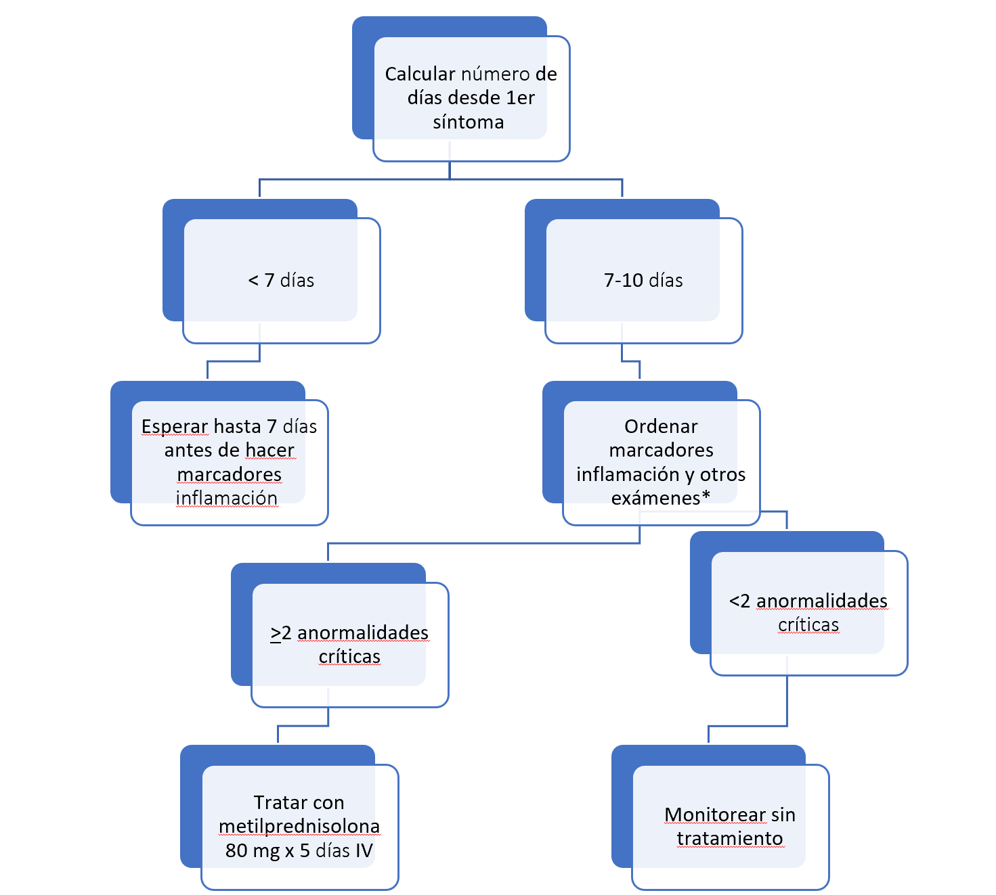
Sinopsis del Manejo de Pacientes Recién Diagnosticados con Covid

Slide 25
Conclusions
1-Out of 210 pts entered, our approach was able to precisely pick 134 cases (64%) who could be safely monitored without treatment, thus avoiding potentially expensive or toxic therapies.
2-Our results support the hypothesis that preemptive treatment with MPS, a potent and inexpensive anti-inflammatory, avoids high risk pts from progressing to Cytokine Storm (p=.0001).
3-Improvement in CRP and Absolute Lymphocyte Count by day 7 correlated well with clinical outcome.
4- A drop in inflammatory markers by day 7 with concurrent increase in Absolute Lymphocyte Count suggests a quick response to MPS.

Slide 26
¿Qué hacer si el paciente presenta en plena tormenta de citoquinas?

Slide 27
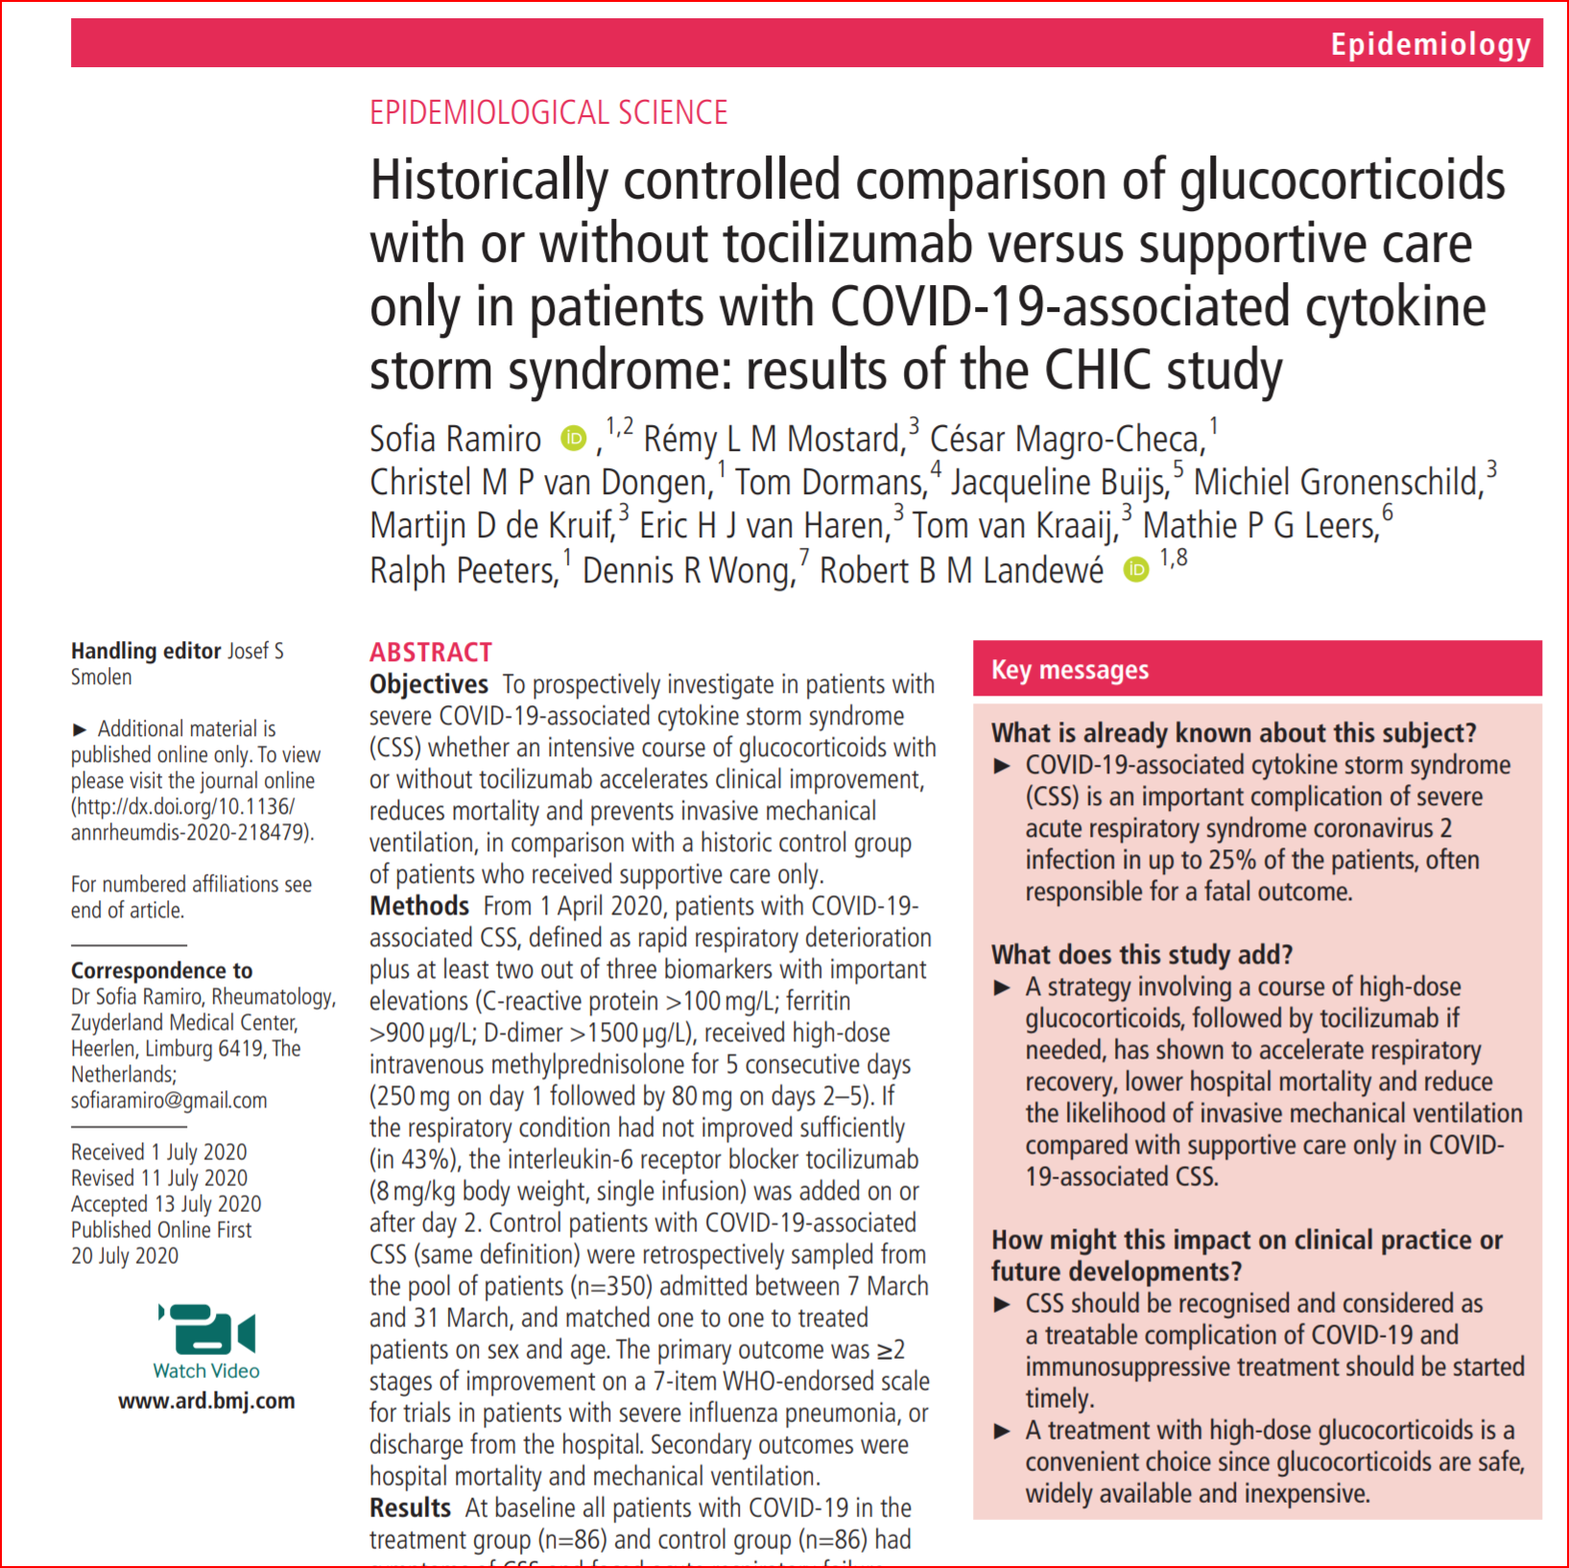

Slide 28
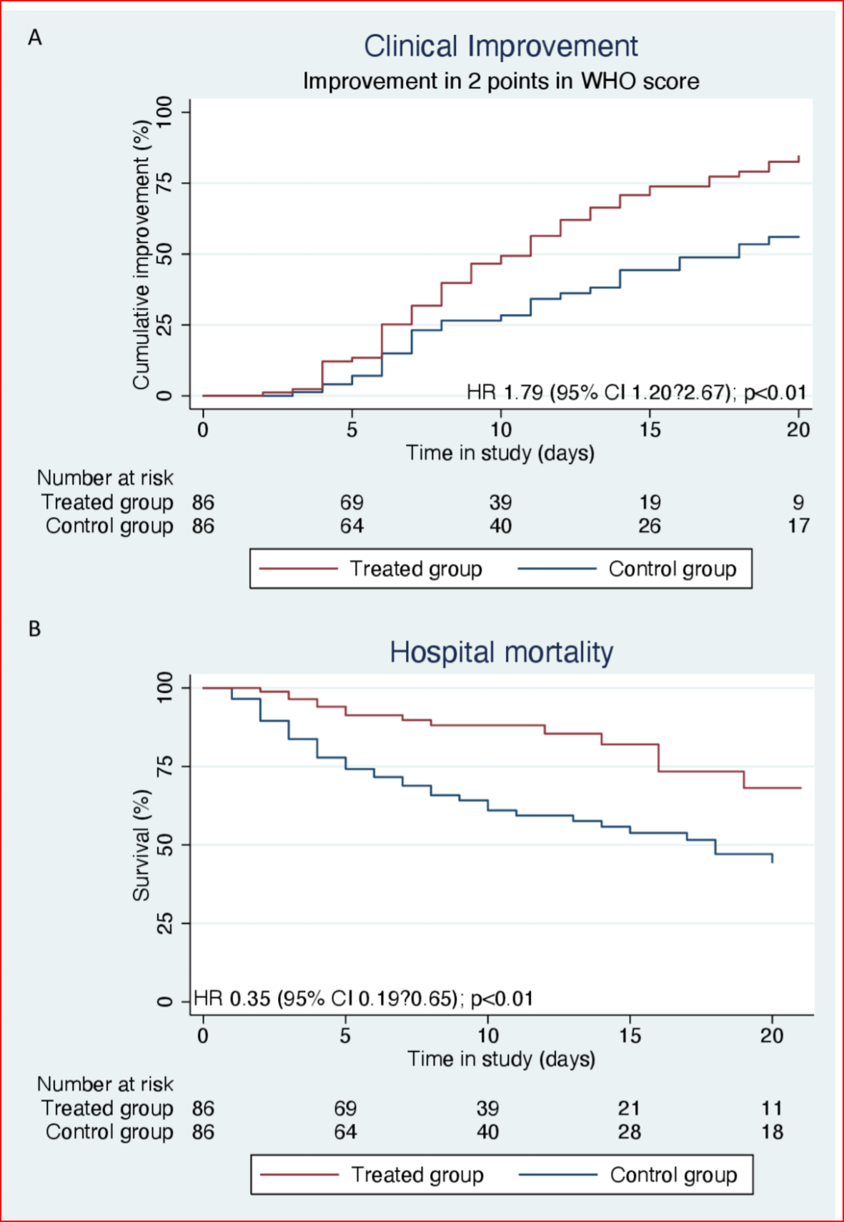

Slide 29
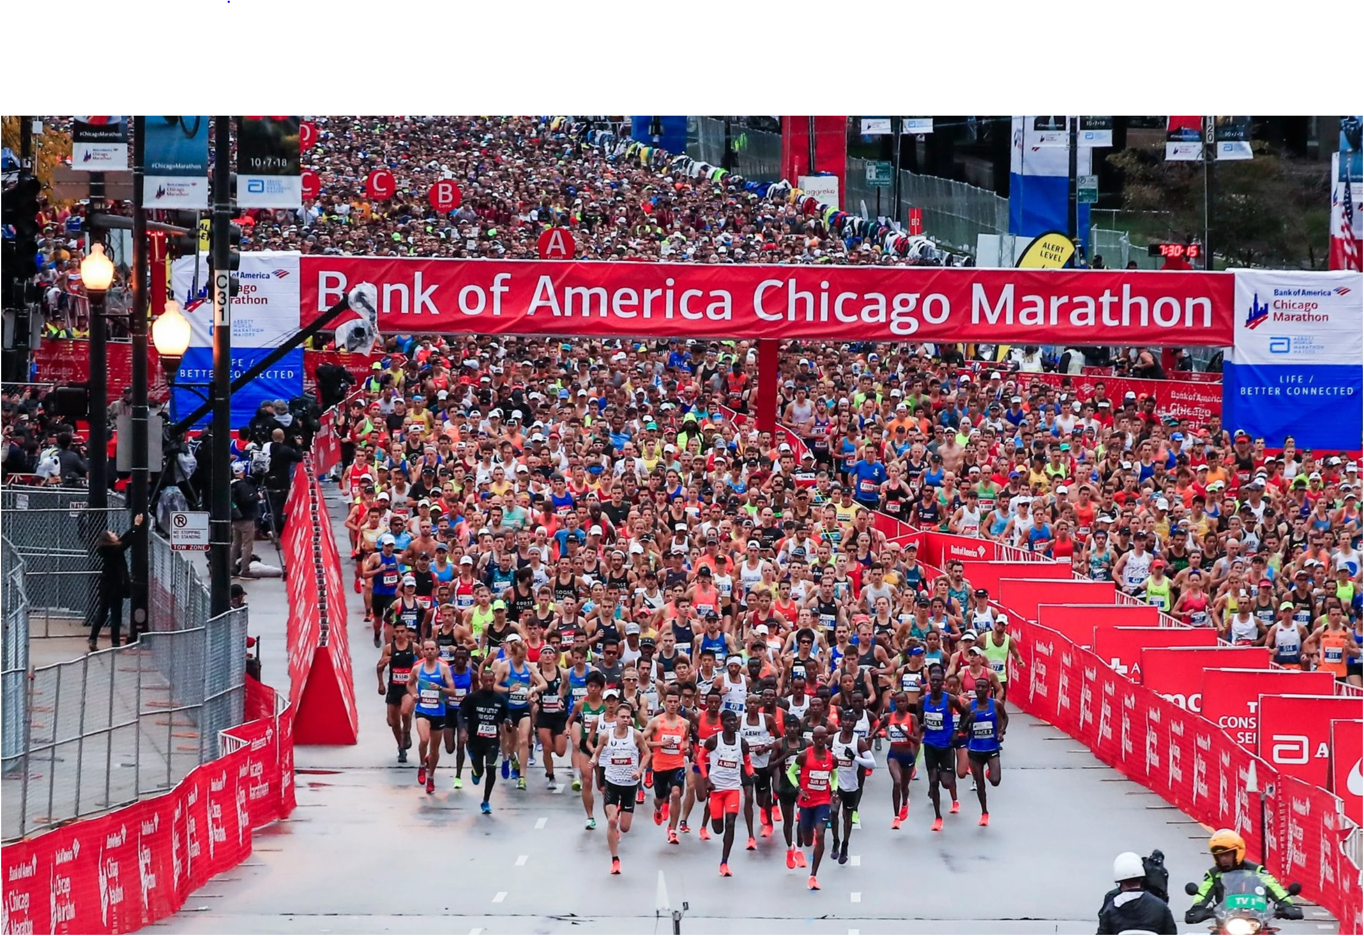
¿Prefieres que el tratamiento de Covid-19 sea un maratón o una carrera de 800 metros?

Slide 30
Reinfections
Supposed to occur rarely
Of our 127 cases not treated, 3 (2%)were reinfected.
All 3 were mild cases
None of the 2 who were tested, had produced antibodies at time of first infection, neither IgM or IgG
It is well known that patients with mild infections produce small amount of antibodies
Two of the reinfected cases required treatment at time of reinfection

Slide 31
Para información detallada acerca del manejo de Covid con nuestro protocolo y para ver resultados ir a:
https://www.prcci.org/tratamiento-covid19

